Slide 1
E-COMMERCE ANALYSIS
Gayathri
DW74

Slide 2
PROBLEM STATEMENT
In the rapidly evolving landscape of e-commerce, understanding customer behavior and optimizing business strategies are crucial for success. A leading e-commerce platform aims to enhance its market position and increase revenue by leveraging data-driven insights. The company seeks to analyze its existing data to identify trends, patterns, and areas for improvement across various aspects of its operations.

Slide 3
TOOLS USED
Visual studio code
Python libraries
Pandas
Seaborn
Matplotlib
Plotly

Slide 4
APPROACH:
Data Collection
Json document from mentor
Converted that to dataFrame
Data Cleaning
Removing null values
Filling missing values
Removing unwanted columns
Exploratory Data Analysis (EDA)
Attribute wise data visualization for data driven decisions
Recommendations and Insights

Slide 5
Exploratory data analysis(EDA)

Slide 6
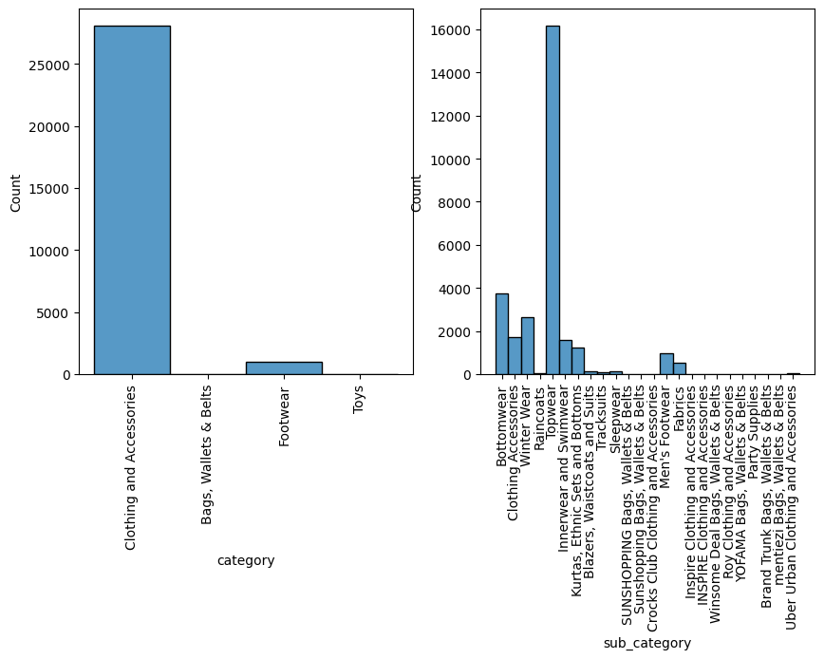

Slide 7
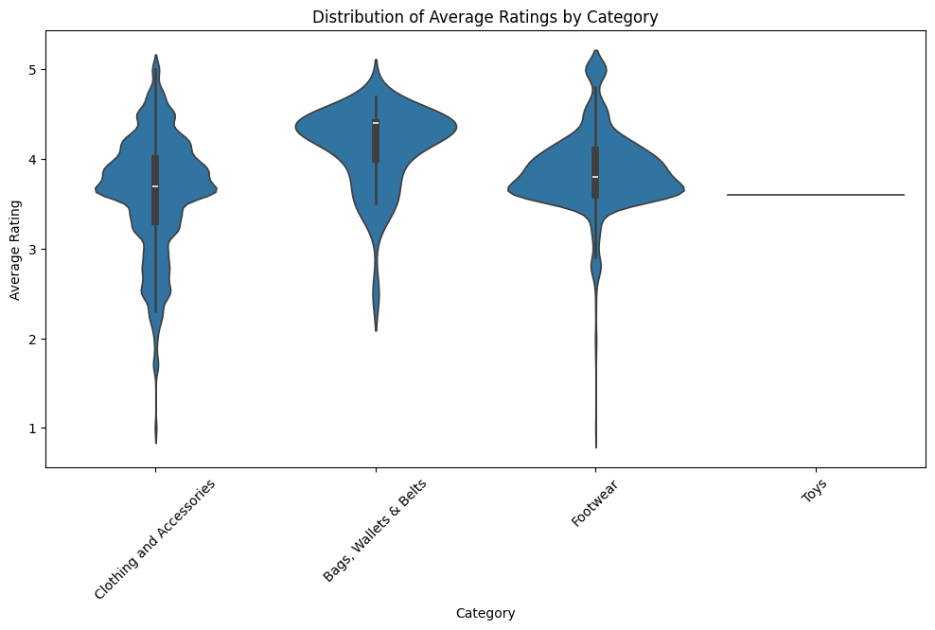

Slide 8
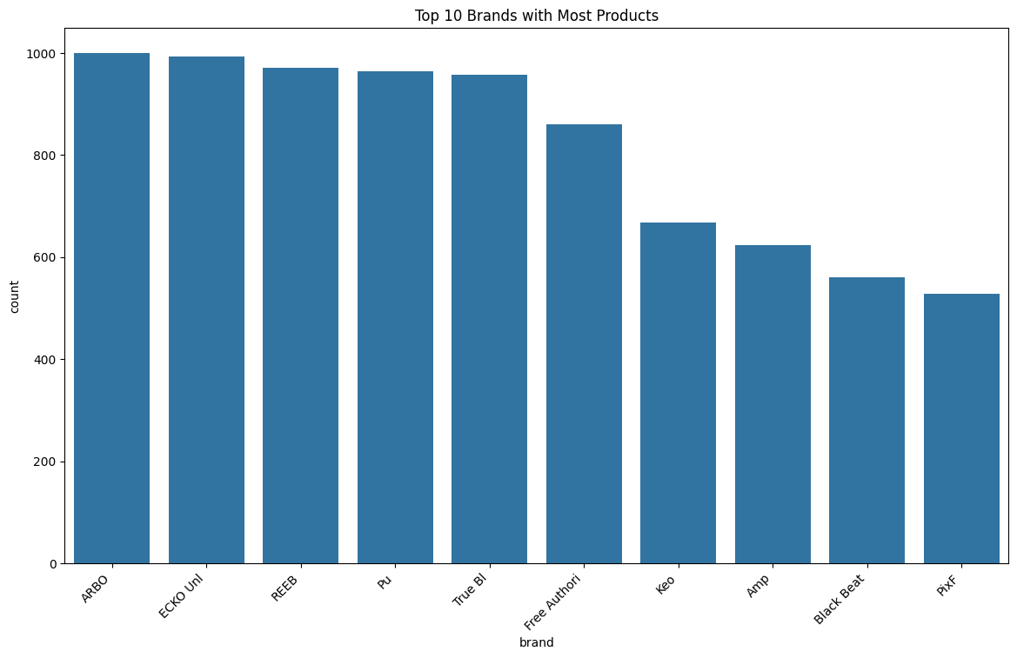

Slide 9
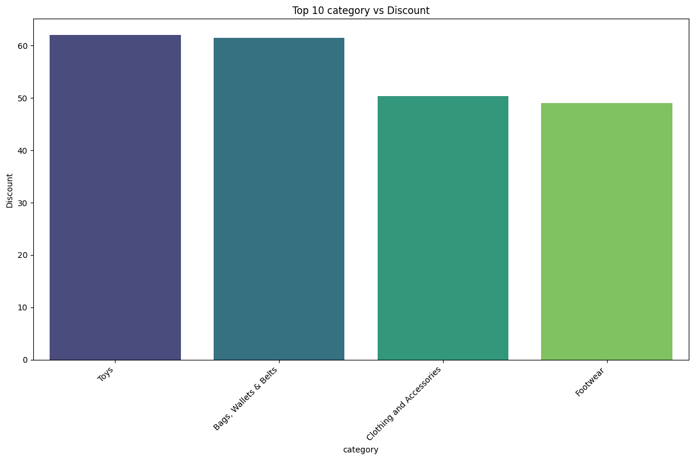

Slide 10
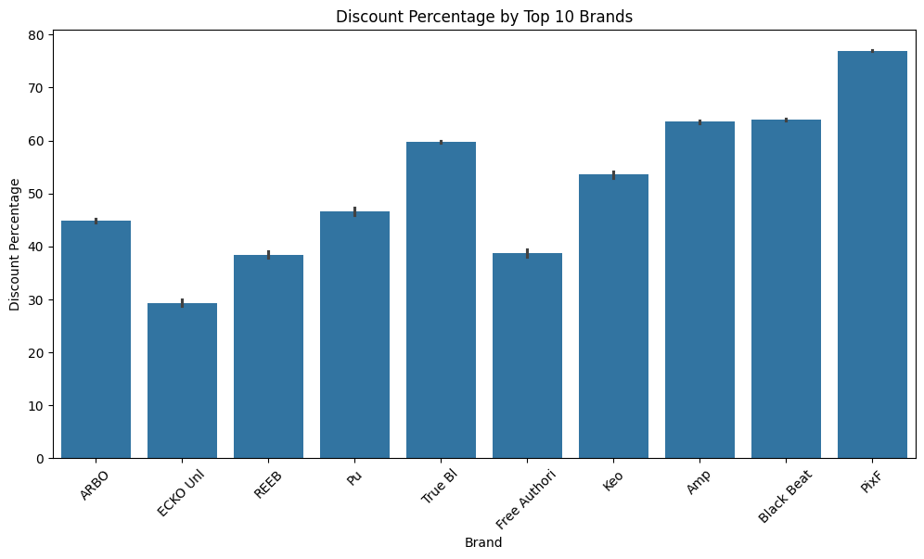

Slide 11
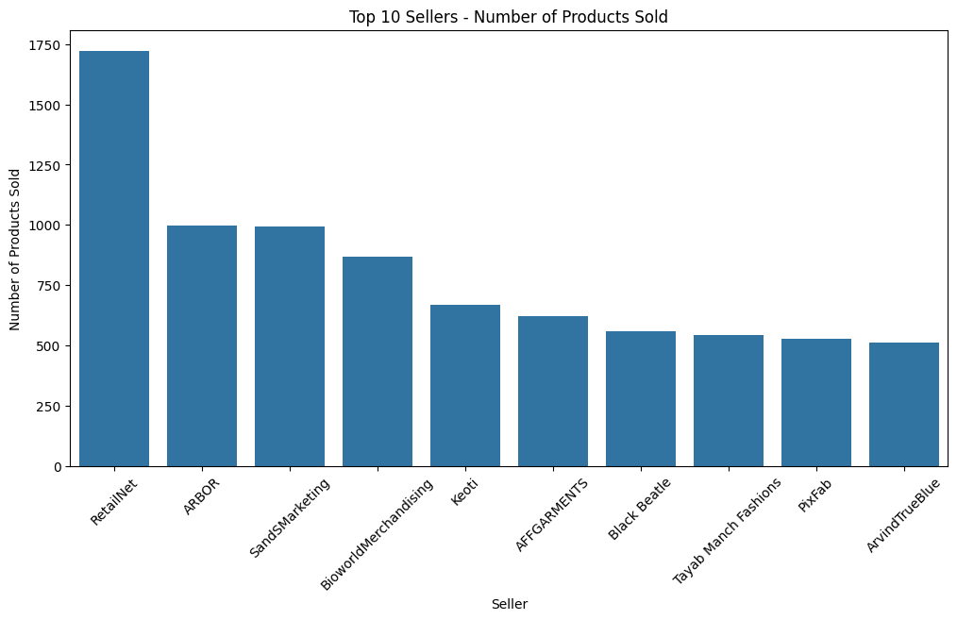

Slide 12
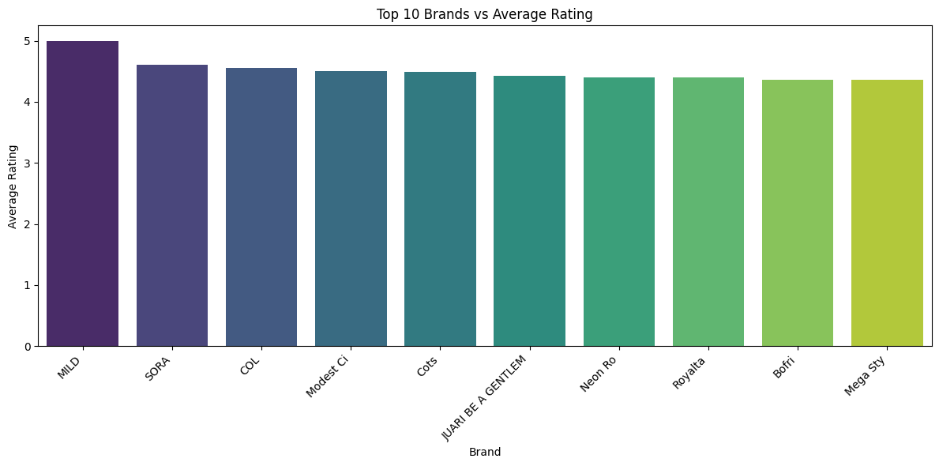
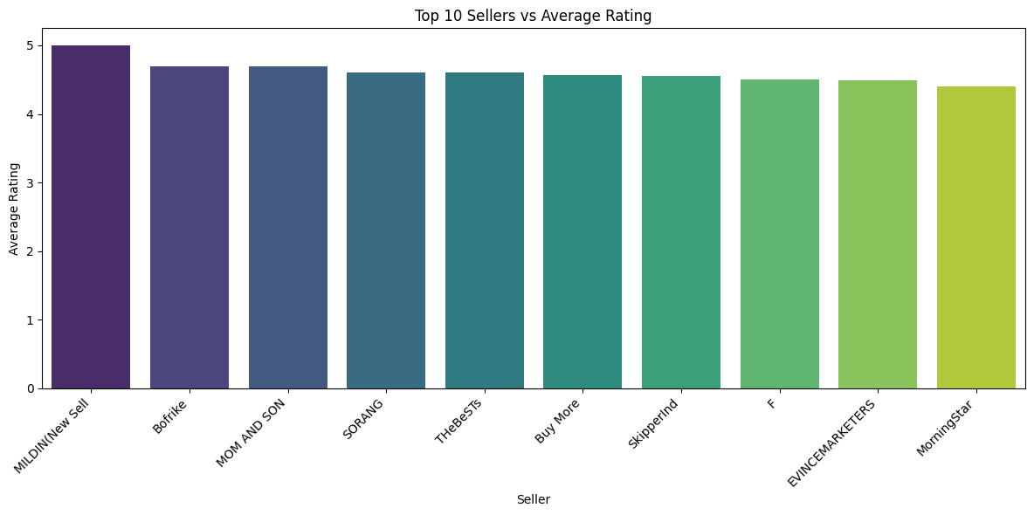

Slide 13
INSIGHTS:
People buying more clothing and accessories in ecommerce platform.
People prefer ARBO brand and RetailNet seller in ecommerce platform .
People more interested in buying top wear is ecommerce platform.
In ecommerce platform products actual price distributed mostly in the range of 500-2500.
In ecommerce platform products selling price distributed mostly in the range of 200-2000..

Slide 14
In ecommerce platform products rating distributed mostly in the range of 3-4.5.
In ecommerce platform products discount distributed mostly in the range of 35% to 65% and the overall Average Discount Percentage is 50.70%
In ecommerce platform bags wallets & belts category has high rating around 4.5.
MILD brand has highest rating around 4.9,and MILDIN seller has rating around 4.9.
In ecommerce platform toys category has high discount around 65%

Slide 15
THANK YOU

